Slide 1

Cardlytics
August Signature Event
Catherine Chu & Nadine Carter

Slide 2

Handling Difficult Conversations:
Proven Strategies for Women Leaders
Presented by: Karla Brandau, CSP, RCC, CEO
Brandau Power Institute

Slide 3
Roll Call with Michelle

Slide 4
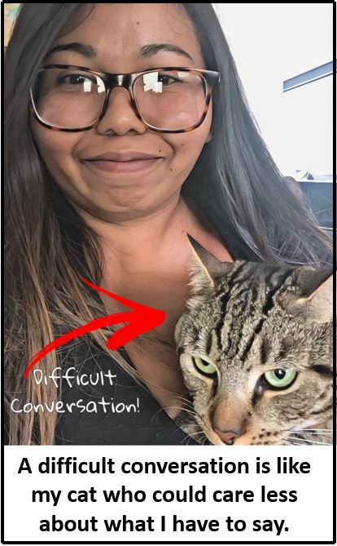
Difficult Conversations are like …

Slide 5
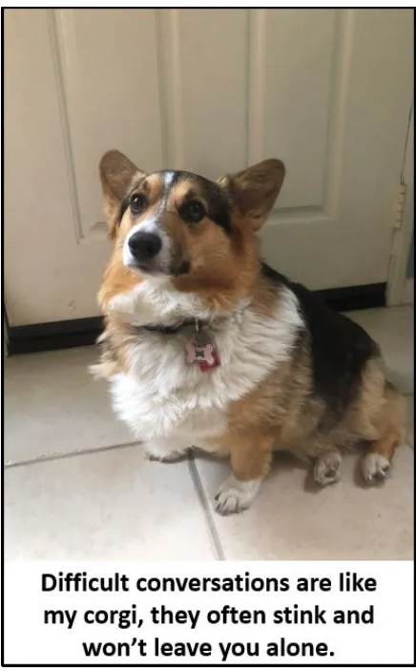
Difficult Conversations are like …

Slide 6

Difficult Conversations are like …
… Crawling through mud.

Slide 7

Put your expressions of what a difficult conversation is in the chat box.

Slide 8
Chat Window:
When you need to have a difficult conversation, what do you do?
Put A, B, C, or D in the chat window.
A – Avoid it until there is an explosion?
B – Ignore it and sweep it under the rug?
C – Tell them the way it is and set them straight?
D – Prepare your message and deliver your message in an assertive way?

Slide 9

Today’s Agenda Difficult Conversations,
Part One
Conversation crashes and snarky comments
Discerning opposite opinions and purposes
Confronting or restarting conversations
Pre-submitted questions

Slide 10
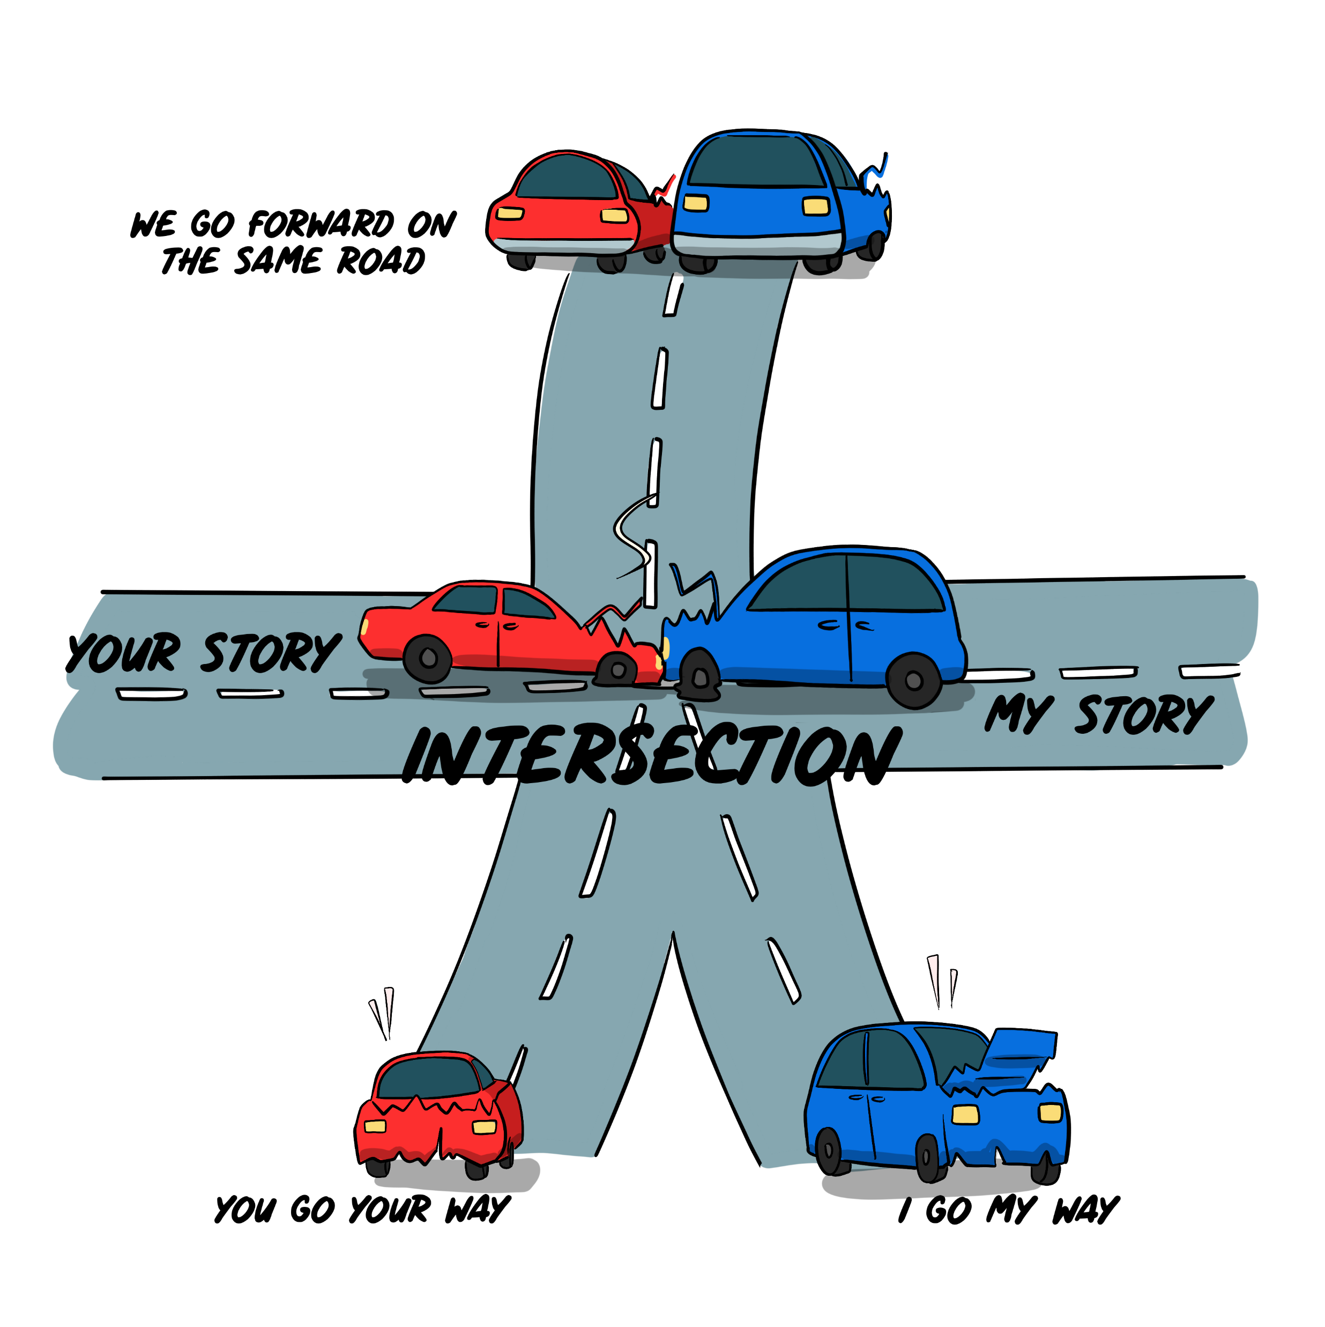
Concept One:
Snarky Comments & Conversations Crashes

Slide 11

Peer to Peer – Criticism about choice of restaurant
“That meal was soooooo bad. Why did you pick that restaurant? I’m sure our clients were as disgusted as I was.”
(Spoken in an appalled tone of voice.)

Slide 12
Snarky, Sarcastic Comebacks
“Ha Ha – just getting back at you for your choice last week when my entrée salad was cup size.”
“Why didn’t you pick the restaurant, Mr. Knows-it-all about food.”
“I wanted you to have Montezuma’s revenge.”

Slide 13
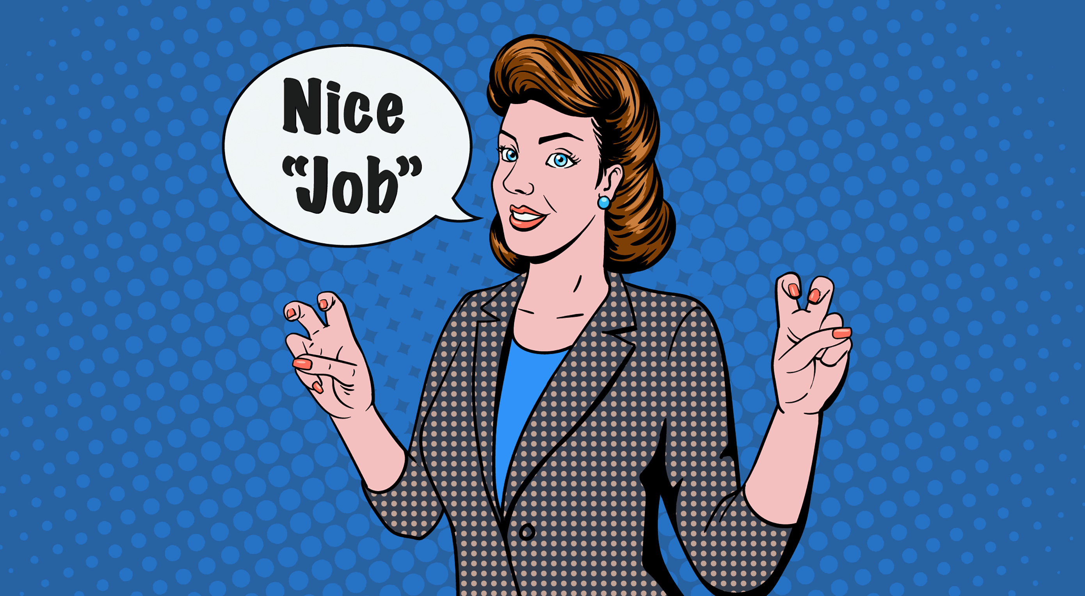

Sarcasm:
Sarcasm is used to convey the opposite of the literal words spoken, and it's primarily communicated by a person's tone of voice.

Slide 14
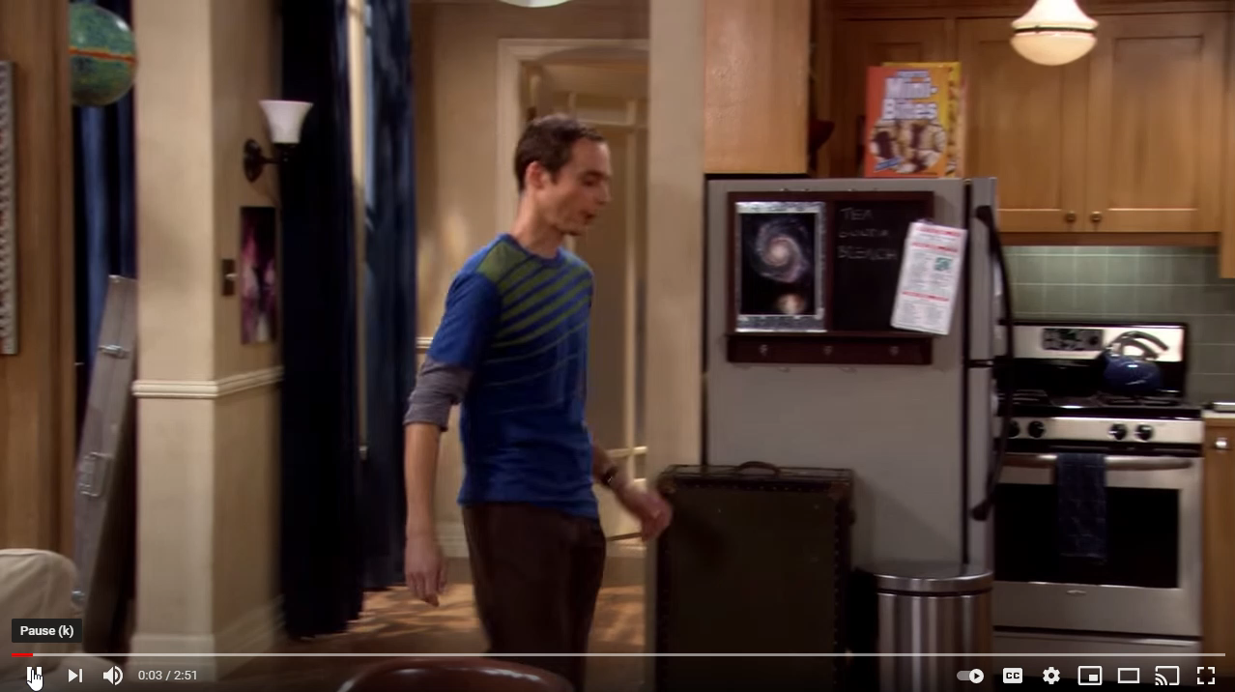
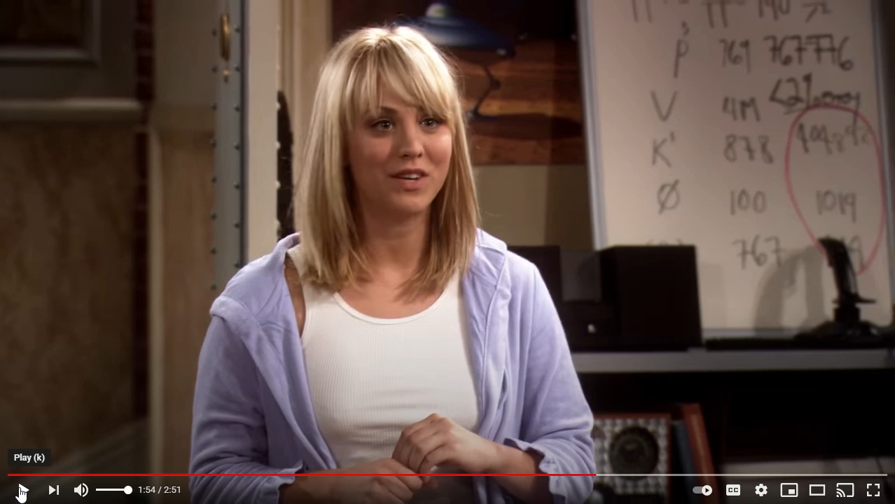
Sheldon and Sarcasm
Full Video Click Here

Slide 15
Peer to Peer - Restaurant
Why do people give snarky comments?
To:
  Be funny – (Sitcom Humor)
  Express disapproval or scorn in a seemingly “humorous” way
  Express hidden anger
  Express passive-aggressive feelings
  Assert dominance over you

Slide 16
Peer to Peer - Restaurant
Professional Response
“I apologize if you didn’t like the restaurant. It is close to the office building and saved us travel time. I should have checked the menu.”
“I have eaten there before and thought the food was good. I agree that today’s meal was a B – maybe a B+ but certainly not an A.”
“I’m sorry you didn’t like your meal. Next time we have clients in town, I’ll get your input on where to eat.”

Slide 17
Chat Question:
What mental thoughts and emotions go through your head that you must control to give a professional response versus a snarky comeback?

Slide 18
Do you have to control:
Anger
Frustration
Disappointment
Hurt
Revenge
Tone of voice
Facial muscles
Body language
Notes:
Ask Michelle did we have any responses in the chat window

Slide 19


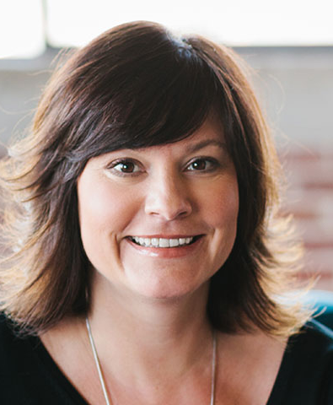
A personal story from Lynne Laube.

Slide 20
Concept Two:
Acknowledging differing opinions or purposes.

Slide 21

Different backgrounds, generations, personalities, agendas, purposes, education, titles, etc.

Slide 22
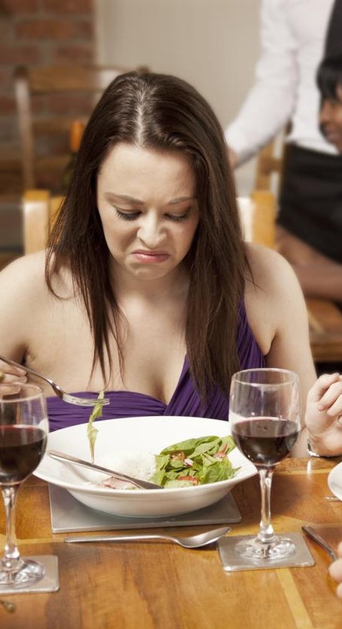
Two Opinions of the Bad Restaurant:
My Opinion: The restaurant was close and saved travel time. Even though the food was not A – we had a great conversation.
Other Opinion: The food was so bad that I could not concentrate. I was very worried about the opinion of our guests.

Slide 23
Opposing Opinions and the “Adult” conversation
Listening to another person’s opinion is the highest form of respect.
Understanding their opinion extends human dignity.
When the other person is listened to, their stress level/anger decreases.
Self-esteem increases.
You may get information to change your opinion.

Slide 24
Part Three:
Confronting as the “Crash” happens or Restarting Conversations.

Slide 25

Address as the “crash” happens

Slide 26

Boundaries
Personal boundaries are guidelines, rules or limits that a person creates to identify reasonable, safe and permissible ways for other people to behave towards them and how they will respond when someone passes those limits.

Slide 27
Possible Boundary Statements
That is not what I meant.
What do you mean by that?
May we discuss what you just said?
Can you explain why you feel that way?
What would you add? Put it in the chat.

Slide 28

Revisit
Prep your conversation
Be aware of their possible opinion
Bring the two opinions together with the “And Stance.”
Ask permission to revisit the conversation.

Slide 29

Thank you for agreeing to revisit our conversation from yesterday. My opinion on the restaurant choice was that the restaurant was close and saved travel time. Even though the food was not A – we had a great conversation.
As I have thought about it, I believe your opinion could be that the food was so bad that you could not concentrate, and you were worried the guests would feel the same way. Did I capture your thoughts correctly?

Slide 30
Assertive Delivery
Cool & calm
Convert anger into positive energy
Well modulated tone (Not too many upglides)
Lower registers of your voice
Direct eye contact
Level Chin

Slide 31
Attitudes and Egos
Eliminate weak, uncertain phrases:
I think …
I feel … (if said in a whining tone of voice)
Kind of …
I sort of …
I just …
Maybe …
Use a strong voice and these words:
I RECOMMEND …
I PROPOSE …
My SUGGESTION is …
My ADVICE is …

Slide 32
Attitudes and Egos
Parrot their words back to them, indicating you heard them.
Talk FACTS – disassociate emotions.
Make “I feel …” statements strong.
Be strong, confident and direct.
If you cannot make headway, take a time out to reorganize your thoughts and strategy.

Slide 33

Remove yourself from the situation. Do not display weakness.
No slumped shoulders
No quivering lip or voice
No head down
No tears
No shuffling feet
You go away and regroup!

Slide 34

“People who fight fire with fire usually end up with ashes.”
~ Abigail Van Buren

Slide 35
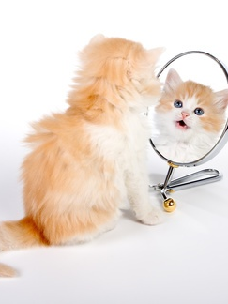
By the way you stand, by your voice, your body language, you demand respect, and you give respect.

Slide 36
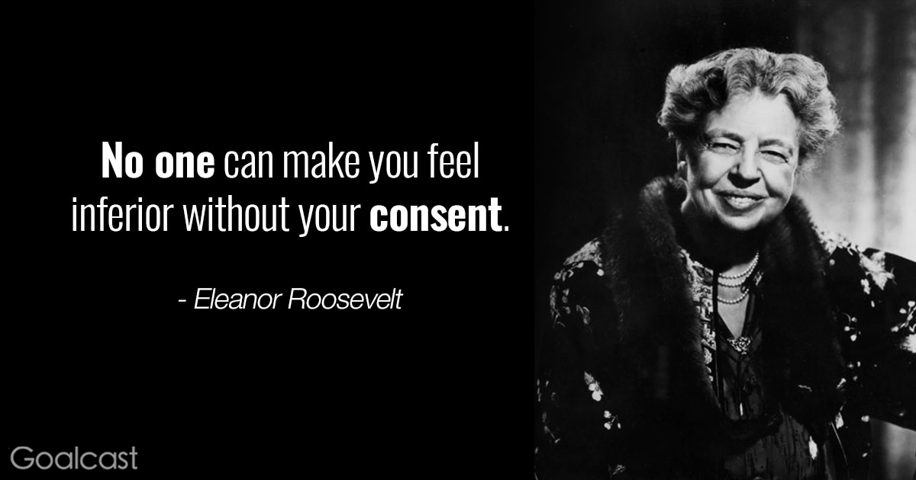

Slide 37
When people don’t agree with you – don’t take it personally. You can’t be validated or get exactly what you want all the time.
New Viewpoint:
They don’t agree with the IDEA.
They are not putting me down.

Slide 38

The Powerful Woman
It’s about self-confidence: owning what you are going to say. If they don’t agree, it does not offend you because you know who you are.
You are powerful and strong when you can:
  Stand up for yourself without being defensive
  Be firm without being aggressive or mean

Slide 39

Pre-submitted Questions

Slide 40

How do you approach a Director (Dominant Male or Female) with a new idea?
Pre-submitted
Question

Slide 41
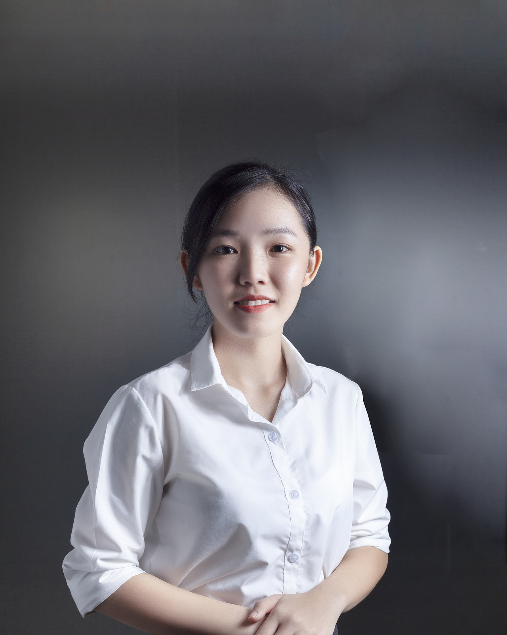
… even if I’m new in the company?
Time in employment, age, doesn’t matter if you have a good idea.
Pre-submitted
Question

Slide 42
Suggestions
How do you approach a Director (Dominant Male or Female) with a new idea?
Be proud of your idea. Stand tall and firm.
Overcome fear of failure, loss, or being “wrong”
Be prepared to state the idea in a convincing manner. Don’t be wordy.
Sell your idea with enthusiasm and FACTS.
Have the pros, the benefits ready to state.
Be prepared for pushback and objections. Be ready to justify why the idea will work.
No rolling of eyes, shrugging of shoulders, negative body language or recoiling.

Slide 43
Suggestions
How do you approach a Director (Dominant Male or Female) with a new idea?
Listen to them their opinion of your idea.
Validate their opinion.
Ask their opinion of your idea.
“I hadn’t thought of it that way.”
Bring the two ideas together. “Could we try ….”
If not accepted, do not display negative, passive-aggressive body language.

Slide 44

How do you have Difficult Conversations with powerful people in positions of authority over you?
Pre-submitted Questions

Slide 45
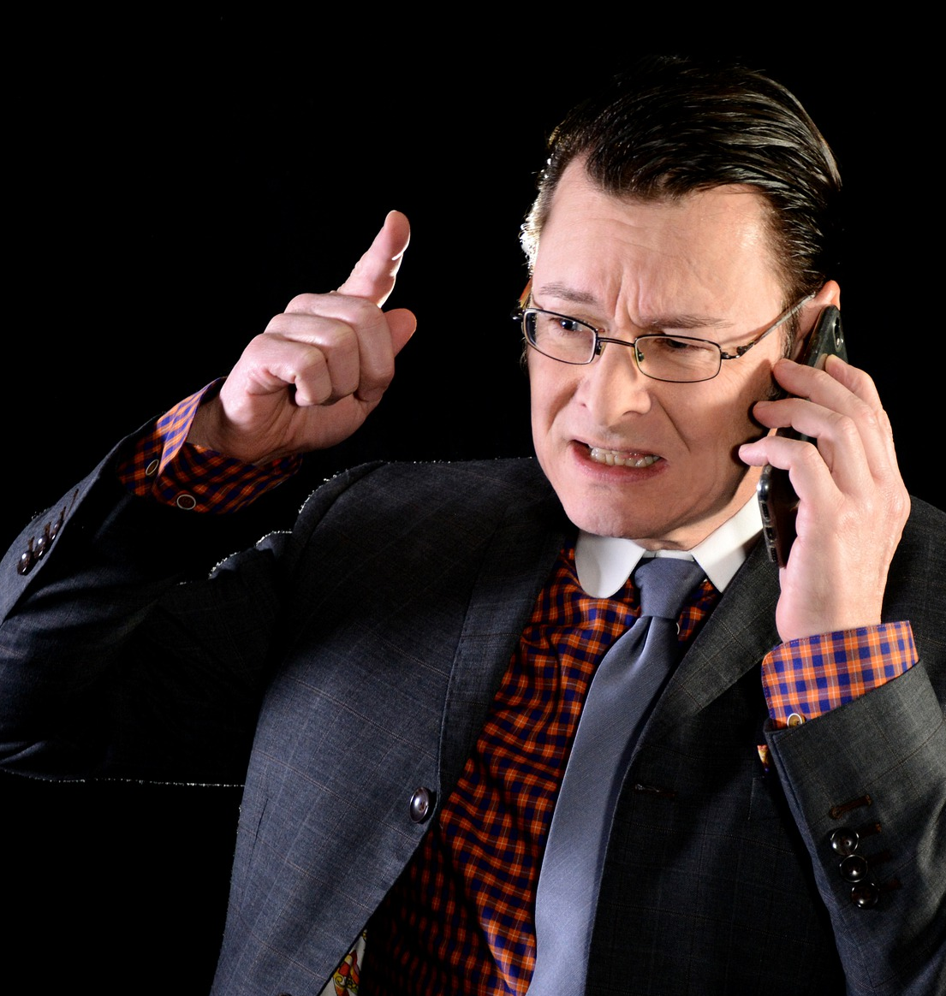
How do you have a difficult conversation with a male director?
Pre-submitted
Question

Slide 46

What do you do when you have to confront a woman manager?

Slide 47

How do you challenge a decision you disagree with made be a higher authority?
Pre-submitted
Question

Slide 48
Strategies for addressing a person in authority over you and/or confronting them for a decision you disagree with.
Body Language Suggestions
Control the anxiety inside
Make direct eye contact
Use a firm (intense), yet relaxed voice
Speak in a steady, even pace
Use a middle range, warm tone
Refrain from over-loud or very quiet.
Stand erect with open body stance and open hands
Show no fear. (Practice this in a mirror.)
Do not recoil after a question or statement.

Slide 49
Suggestions
Strategies for addressing a person in authority over you and/or confronting them for a decision you disagree with.
Be sincere
State your idea/objection in a sound bite.
Convince with FACTS.
Have the pros, the benefits ready
Be sure to think through possible objections.
Have more than one alternative in your mind
Listen to their opinion and connect the two opinions.

Slide 50
Suggestions When you Disagree
Strategies for confronting a person of authority when you disagree with the decision
Pick your battle.
Choose an appropriate time and a private place.
Be respectful and courageous.
Acknowledge the manager’s perspective.
Ask clarifying questions.
Ask if you can explain your perspective.
Listen to their response.

Slide 51
Suggestions When you Disagree
Strategies for confronting a person of authority when you disagree with the decision
State your reasons for disagreement in a soundbite.
Have any facts and figures available.
Make a comparison of your plan and their plan.
Have more than one convincing sound bite.
Listen to their opinion and connect the two ideas.
“Would you consider ….”
Know when to move on.
Don’t go around the manager.

Slide 52

Being successful in Difficult Conversations is an ART…like painting a picture.
There is no guarantee of success.
You can’t control other people’s behaviors

Slide 53

Do you see common themes when handling dominant people?

Slide 54
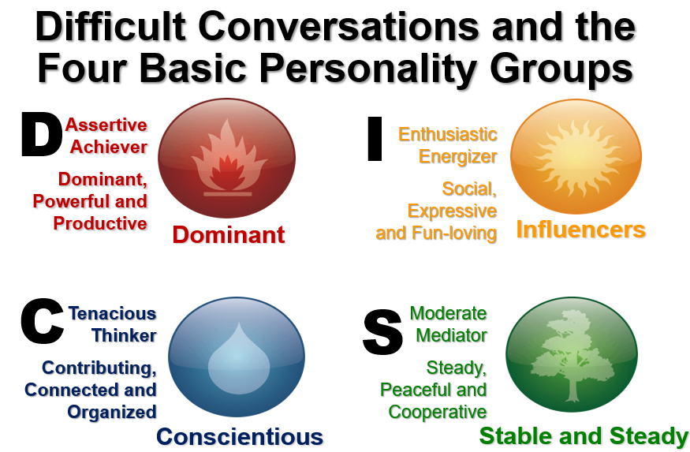
Next session in October
Pre-submitted questions
about the pace of conversations and what to do with someone who has an opposite communication style.
Please visit Cardlytics Portal for Pre-Submitted Questions

Slide 55

Next session in October
Pre-submitted questions
about avoiding the “Witchy” label.
Please visit Cardlytics Portal for Pre-Submitted Questions

Slide 56

FINAL QUESTIONS?

